Slide 1
Konsep datamining

Slide 2
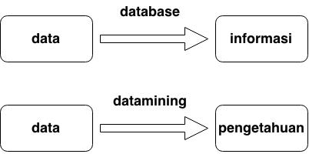
Database vs datamining

Slide 3
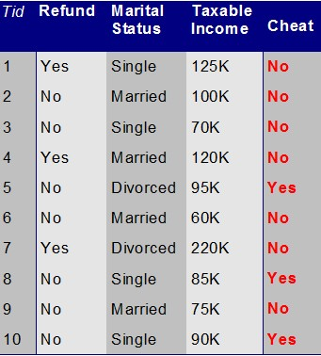
Database vs datamining
Contoh : tabel data pembelian kendaraan bermotor secara kredit
Data yang disimpan antara lain
  Refund = pengembalian pajak
  Marital status = status perkawinan
  Taxable income = penghasilan
  status angsuran kendaraan cheat yes = curang dan Cheat no = angsuran lancar
Jelaskan data pada baris 3, 6, 10

Slide 4
Database vs datamining
Dengan database / SQL kita bisa mendapat INFORMASI. Misal :
Berapa jumlah transaksi yang lancar
Berapa jumlah transaksi yang macet
Berapa rata-rata penghasilan kreditur yang transaksinya macet
Berapakah customer dengan status menikah yang angsurannya lancar

Slide 5
Database vs datamining
Dengan DATAMINING kita bisa mendapat PENGETAHUAN
Bagaimana pola / ciri-ciri customer yang pembayarannya lancar
Pola / ciri-ciri customer yang pembayarannya menunggak
Jika menggunakan database / SQL apakah kita bisa mendapat pengetahuan tersebut? Jelaskan

Slide 6
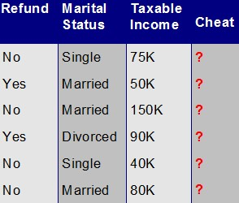
Database vs datamining
Manfaat : Dengan pengetahuan yang didapat melalui DATAMINING kita bisa MENEBAK apakah calon debitur pembayarannya lancar atau menunggak
Bisa digunakan untuk membuat aplikasi SPK untuk menerima / menolak permohonan kredit motor
Jika hanya menggunakan database / SQL apakah kita bisa membuat aplikasi peramalan tersebut? Jelaskan

Slide 7
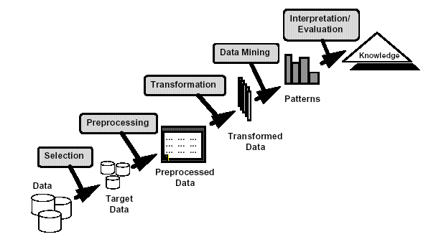
What is Data Mining?
Definisi datamining : eksplorasi dan analisa data yang jumlahnya banyak untuk menemukan pola-pola tersembunyi (pengetahuan) di data tersebut menggunakan algoritma tertentu
Many Definitions
  Non-trivial extraction of implicit, previously unknown and potentially useful information from data
  Exploration & analysis, by automatic or
  semi-automatic means, of
  large quantities of data
  in order to discover
  meaningful patterns

Slide 8
What is (not) Data Mining?
What is not Data Mining?
  Look up phone number in phone directory
  Query a Web search engine for information about “Amazon”
What is Data Mining?
  Certain names are more prevalent in certain US locations (O’Brien, O’Rurke, O’Reilly… in Boston area)
  Group together similar documents returned by search engine according to their context (e.g. Amazon rainforest, Amazon.com,)
Contoh aplikasi datamining
Contoh aplikasi database biasa

Slide 9



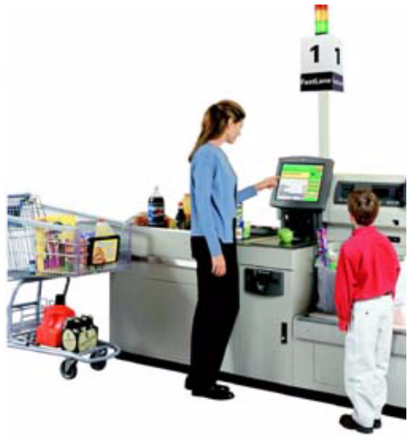
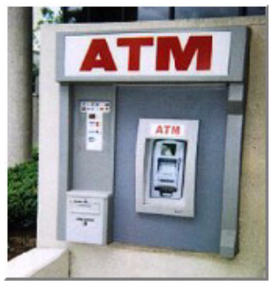
Why Mine Data? Commercial Viewpoint
Alasan munculnya datamining
Data yang tersimpan di database server di seluruh dunia sangat banyak
Sayang jika data tersebut hanya diolah menjadi informasi.
Kita harrus mengambil pengetahuan yang tersimpan di database tersebut
Lots of data is being collected
and warehoused
  Web data, e-commerce
  purchases at department/
  grocery stores
  Bank/Credit Card
  transactions
Computers have become cheaper and more powerful
Competitive Pressure is Strong
  Provide better, customized services for an edge (e.g. in Customer Relationship Management)

Slide 10
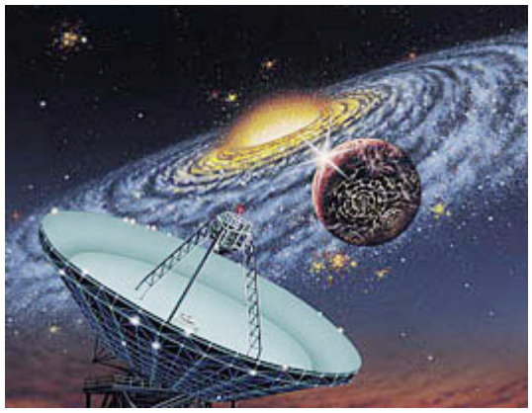
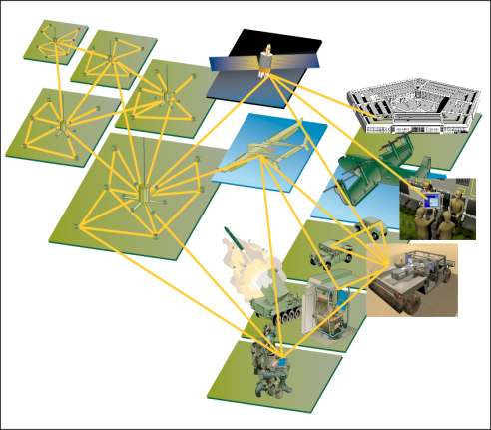
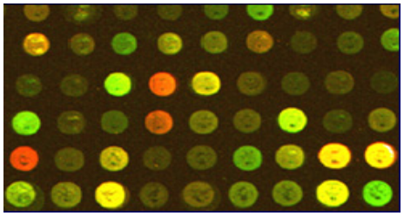
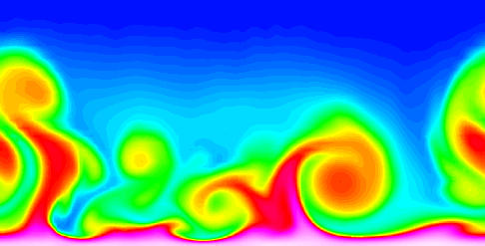
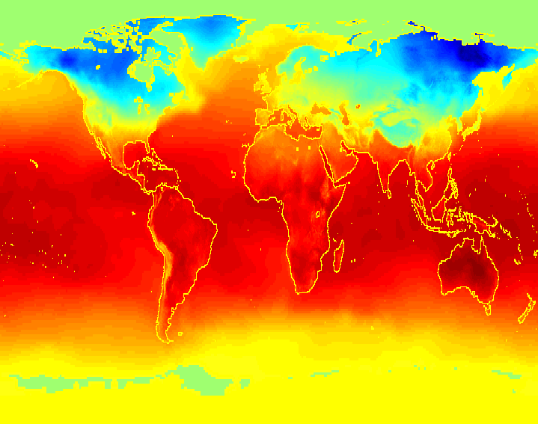
Why Mine Data? Scientific Viewpoint
Data collected and stored at
enormous speeds (GB/hour)
  remote sensors on a satellite
  telescopes scanning the skies
  microarrays generating gene
  expression data
  scientific simulations
  generating terabytes of data
Traditional techniques infeasible for raw data
Data mining may help scientists
  in classifying and segmenting data
  in Hypothesis Formation

Slide 11
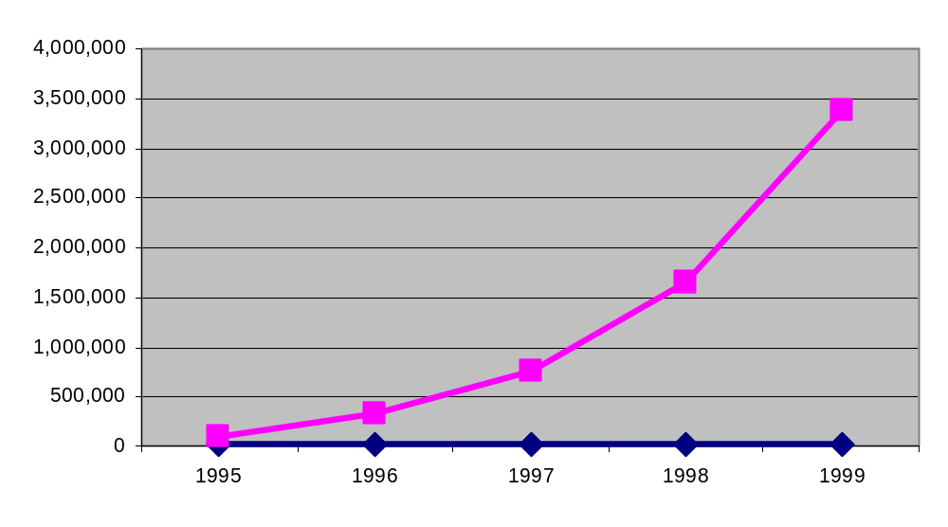
Mining Large Data Sets - Motivation
There is often information “hidden” in the data that is
not readily evident
Human analysts may take weeks to discover useful information
Much of the data is never analyzed at all
The Data Gap
Total new disk (TB) since 1995
Number of analysts
From: R. Grossman, C. Kamath, V. Kumar, “Data Mining for Scientific and Engineering Applications”

Slide 12
Origins of Data Mining
Bidang ilmu yang digunakan di datamining
Draws ideas from machine learning/AI, pattern recognition, statistics, and database systems
Traditional Techniques
may be unsuitable due to
  Enormity of data
  High dimensionality
  of data
  Heterogeneous,
  distributed nature
  of data
Statistics/
AI
Machine Learning/
Pattern
Recognition
Data Mining
Database systems

Slide 13
Data Mining Tasks
Ilmu datamining terdiri atas dua bagian
Deskriptif : mencari pola / pengetahuan yang tersembunyi di data
Prediktif : Menggunakan pengetahuan yang telah didapat untuk meramalkan data di masa depan
Prediction Methods
  Use some variables to predict unknown or future values of other variables.
Description Methods
  Find human-interpretable patterns that describe the data.
From [Fayyad, et.al.] Advances in Knowledge Discovery and Data Mining, 1996

Slide 14
Data Mining Tasks...
Classification [Predictive]
Clustering [Descriptive]
Association Rule Discovery [Descriptive]
Sequential Pattern Discovery [Descriptive]
Regression [Predictive]
Deviation Detection [Predictive]
Beberapa kajian di datamining

Slide 15
Classification: Definition
Given a collection of records (training set )
  Each record contains a set of attributes, one of the attributes is the class.
Find a model for class attribute as a function of the values of other attributes.
Goal: previously unseen records should be assigned a class as accurately as possible.
  A test set is used to determine the accuracy of the model. Usually, the given data set is divided into training and test sets, with training set used to build the model and test set used to validate it.

Slide 16


Classification Example
Klasifikasi
Data terdiri atas beberapa kategori / class
Mencari ciri-ciri / pola setiap class
Pola yang ditemukan digunakan untuk menebak memprediksi data yang belum diketahui classnya
Contoh : aplikasi untuk menerima / menolak kredit kendaraan bermotor
categorical
categorical
continuous
class
Test
Set
Learn
Classifier
Training
Set
Model

Slide 17
Classification: Application 1
Contoh – contoh penggunaan klasifikasi
Direct Marketing
  Goal: Reduce cost of mailing by targeting a set of consumers likely to buy a new cell-phone product.
  Approach:
    Use the data for a similar product introduced before.
    We know which customers decided to buy and which decided otherwise. This {buy, don’t buy} decision forms the class attribute.
    Collect various demographic, lifestyle, and company-interaction related information about all such customers.
      Type of business, where they stay, how much they earn, etc.
    Use this information as input attributes to learn a classifier model.
From [Berry & Linoff] Data Mining Techniques, 1997

Slide 18
Classification: Application 2
Fraud Detection
  Goal: Predict fraudulent cases in credit card transactions.
  Approach:
    Use credit card transactions and the information on its account-holder as attributes.
      When does a customer buy, what does he buy, how often he pays on time, etc
    Label past transactions as fraud or fair transactions. This forms the class attribute.
    Learn a model for the class of the transactions.
    Use this model to detect fraud by observing credit card transactions on an account.

Slide 19
Classification: Application 3
Customer Attrition/Churn:
  Goal: To predict whether a customer is likely to be lost to a competitor.
  Approach:
    Use detailed record of transactions with each of the past and present customers, to find attributes.
      How often the customer calls, where he calls, what time-of-the day he calls most, his financial status, marital status, etc.
    Label the customers as loyal or disloyal.
    Find a model for loyalty.
From [Berry & Linoff] Data Mining Techniques, 1997

Slide 20
Classification: Application 4
Sky Survey Cataloging
  Goal: To predict class (star or galaxy) of sky objects, especially visually faint ones, based on the telescopic survey images (from Palomar Observatory).
      3000 images with 23,040 x 23,040 pixels per image.
  Approach:
    Segment the image.
    Measure image attributes (features) - 40 of them per object.
    Model the class based on these features.
    Success Story: Could find 16 new high red-shift quasars, some of the farthest objects that are difficult to find!
From [Fayyad, et.al.] Advances in Knowledge Discovery and Data Mining, 1996

Slide 21



Classifying Galaxies
Courtesy: http://aps.umn.edu
Early
Class:
Stages of Formation
Attributes:
Image features,
Characteristics of light waves received, etc.
Intermediate
Late
Data Size:
72 million stars, 20 million galaxies
Object Catalog: 9 GB
Image Database: 150 GB

Slide 22
Clustering Definition
Given a set of data points, each having a set of attributes, and a similarity measure among them, find clusters such that
  Data points in one cluster are more similar to one another.
  Data points in separate clusters are less similar to one another.
Similarity Measures:
  Euclidean Distance if attributes are continuous.
  Other Problem-specific Measures.

Slide 23
Illustrating Clustering
Clustering
Data tidak memiliki class
Clustering membagi data menjadi beberapa cluster / kelompok
Pada sebuah kelompok yang terbentuk, anggotanya mirip antara satu dengan yang lain
Euclidean Distance Based Clustering in 3-D space.
Intracluster distances
are minimized
Intercluster distances
are maximized

Slide 24
Clustering: Application 1
Contoh – contoh penggunaan clustering
Market Segmentation:
  Goal: subdivide a market into distinct subsets of customers where any subset may conceivably be selected as a market target to be reached with a distinct marketing mix.
  Approach:
    Collect different attributes of customers based on their geographical and lifestyle related information.
    Find clusters of similar customers.
    Measure the clustering quality by observing buying patterns of customers in same cluster vs. those from different clusters.

Slide 25
Clustering: Application 2
Document Clustering:
  Goal: To find groups of documents that are similar to each other based on the important terms appearing in them.
  Approach: To identify frequently occurring terms in each document. Form a similarity measure based on the frequencies of different terms. Use it to cluster.
  Gain: Information Retrieval can utilize the clusters to relate a new document or search term to clustered documents.

Slide 26
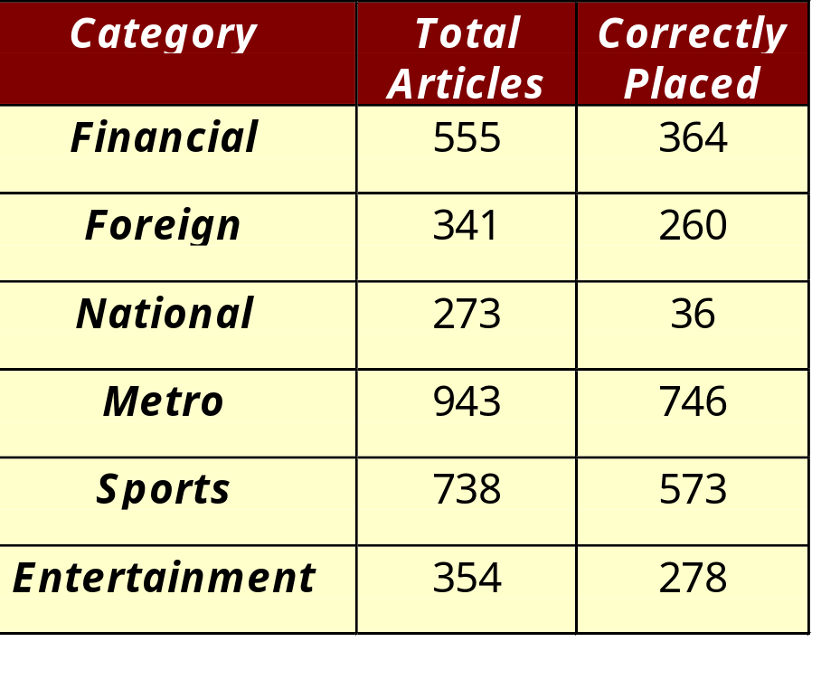
Illustrating Document Clustering
Clustering Points: 3204 Articles of Los Angeles Times.
Similarity Measure: How many words are common in these documents (after some word filtering).

Slide 27
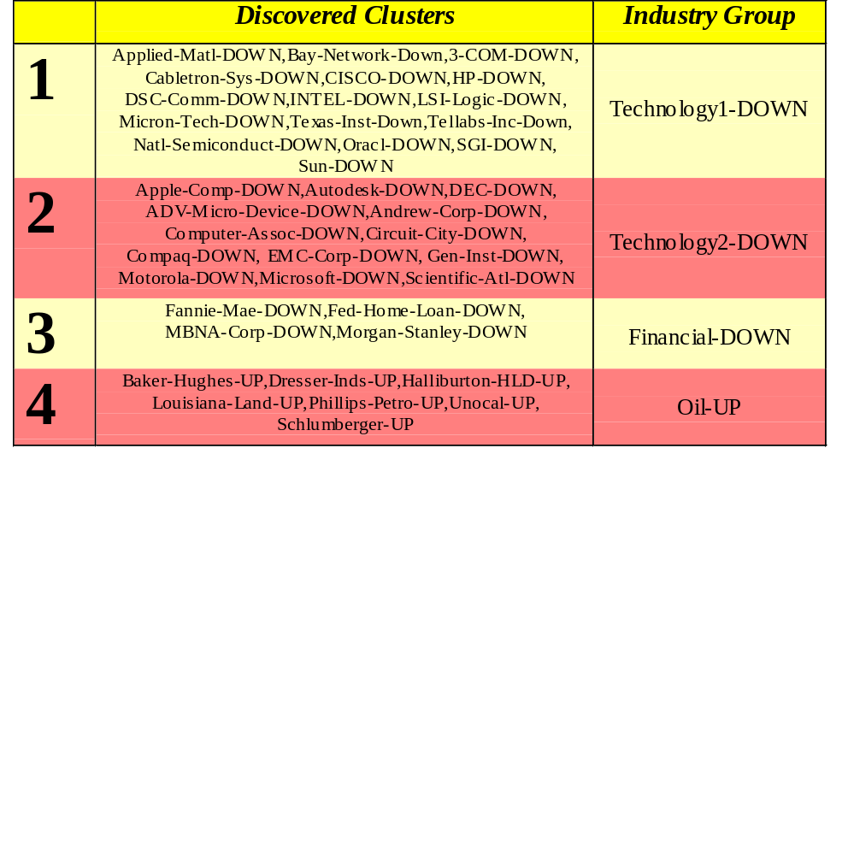
Clustering of S&P 500 Stock Data
Observe Stock Movements every day.
Clustering points: Stock-{UP/DOWN}
Similarity Measure: Two points are more similar if the events described by them frequently happen together on the same day.
  We used association rules to quantify a similarity measure.

Slide 28

Association Rule Discovery: Definition
Association rule
Mencari data apa saja yang sering muncul bersamaan
Misal pada data transaksi penjualan, ada product tertentu yang sering dibeli bersama. Misal : roti dan susu
Digunakan untuk menata layout barang pada supermarket. Yang sering dibeli bersama diletakkan berdekatan
Given a set of records each of which contain some number of items from a given collection;
  Produce dependency rules which will predict occurrence of an item based on occurrences of other items.
Rules Discovered:
{Milk} --> {Coke}
{Diaper, Milk} --> {Beer}

Slide 29
Association Rule Discovery: Application 1
Marketing and Sales Promotion:
  Let the rule discovered be
  {Bagels, … } --> {Potato Chips}
  Potato Chips as consequent => Can be used to determine what should be done to boost its sales.
  Bagels in the antecedent => Can be used to see which products would be affected if the store discontinues selling bagels.
  Bagels in antecedent and Potato chips in consequent => Can be used to see what products should be sold with Bagels to promote sale of Potato chips!

Slide 30
Association Rule Discovery: Application 2
Supermarket shelf management.
  Goal: To identify items that are bought together by sufficiently many customers.
  Approach: Process the point-of-sale data collected with barcode scanners to find dependencies among items.
  A classic rule --
    If a customer buys diaper and milk, then he is very likely to buy beer.
    So, don’t be surprised if you find six-packs stacked next to diapers!

Slide 31
Association Rule Discovery: Application 3
Inventory Management:
  Goal: A consumer appliance repair company wants to anticipate the nature of repairs on its consumer products and keep the service vehicles equipped with right parts to reduce on number of visits to consumer households.
  Approach: Process the data on tools and parts required in previous repairs at different consumer locations and discover the co-occurrence patterns.

Slide 32
Sequential Pattern Discovery: Definition
Sequential pattern discovery
Mencari data yang sering muncul berurutan di database
Contoh : dari medical record RS kita bisa menganalisa gejala penyakit kronis. Misal sebelum sakit jantung didahului kolestrol, hipertensi, dll.
Given is a set of objects, with each object associated with its own timeline of events, find rules that predict strong sequential dependencies among different events.
Rules are formed by first disovering patterns. Event occurrences in the patterns are governed by timing constraints.
(A B) (C) (D E)
(A B) (C) (D E)
<= xg
>ng
<= ws
<= ms

Slide 33
Sequential Pattern Discovery: Examples
In telecommunications alarm logs,
  (Inverter_Problem Excessive_Line_Current)
  (Rectifier_Alarm) --> (Fire_Alarm)
In point-of-sale transaction sequences,
  Computer Bookstore:
  (Intro_To_Visual_C) (C++_Primer) --> (Perl_for_dummies,Tcl_Tk)
  Athletic Apparel Store:
  (Shoes) (Racket, Racketball) --> (Sports_Jacket)

Slide 34
Regression
regresi
Menebak nilai data kontinyu berdasar nilai variabel lain
Misal aplikasi peramalan kecepatan angin menggunakan nilai suhu, kelembaban, tekanan udara, dll.
Predict a value of a given continuous valued variable based on the values of other variables, assuming a linear or nonlinear model of dependency.
Greatly studied in statistics, neural network fields.
Examples:
  Predicting sales amounts of new product based on advetising expenditure.
  Predicting wind velocities as a function of temperature, humidity, air pressure, etc.
  Time series prediction of stock market indices.

Slide 35





Deviation/Anomaly Detection
Anomaly detection
Mencari data yang polanya menyimpang dibanding yang lain
Aplikasi : deteksi penipuan kartu kredit. Pada transaksi palsu, pola transaksi menyimpang dari transaksi biasanya
Detect significant deviations from normal behavior
Applications:
  Credit Card Fraud Detection
  Network Intrusion
  Detection
Typical network traffic at University level may reach over 100 million connections per day

